Slide 1

Harley-Davidson to India
&
Royal Enfield to USA
Rod Copes
November 5, 2015

Slide 2

AGENDA
Introduction
Harley-Davidson overview
Royal Enfield overview
Royal Enfield vs. Harley-Davidson
Global Expansion Challenges
Q & A

Slide 3
My Background
19+ years at Harley-Davidson
Variety of roles – led Global Expansion 2009-2012
Left H-D in late 2012
Now focused on smaller companies / start-ups
Began working with Royal Enfield: July 2014
Tasked with re-launching RE brand in North America

Slide 4


Primary Discussion
Challenges of:
  Taking to India
  Bringing to the USA

Slide 5
Primary Discussion
…..each requires a unique, specific Strategy!

Slide 6
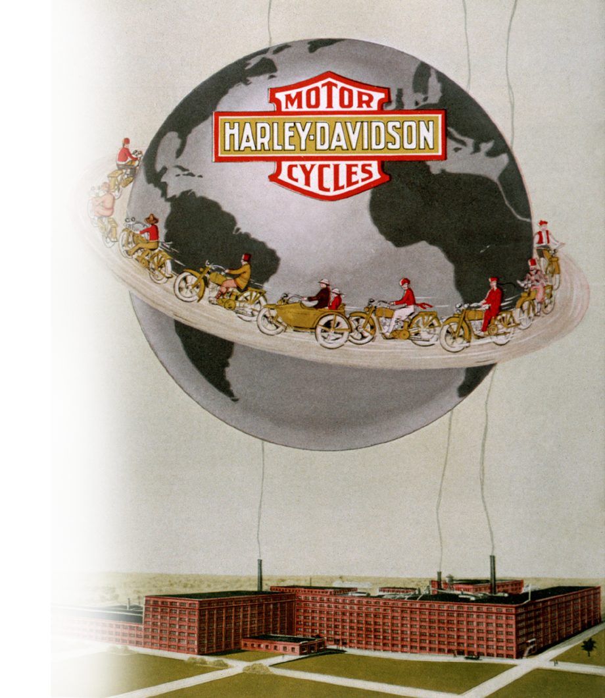
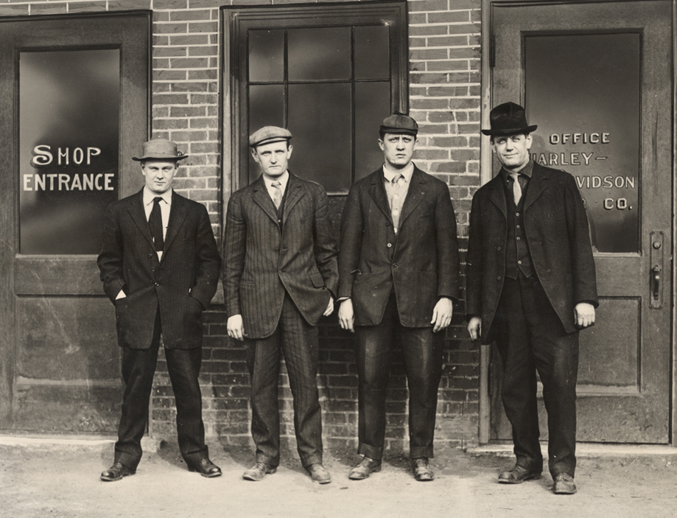
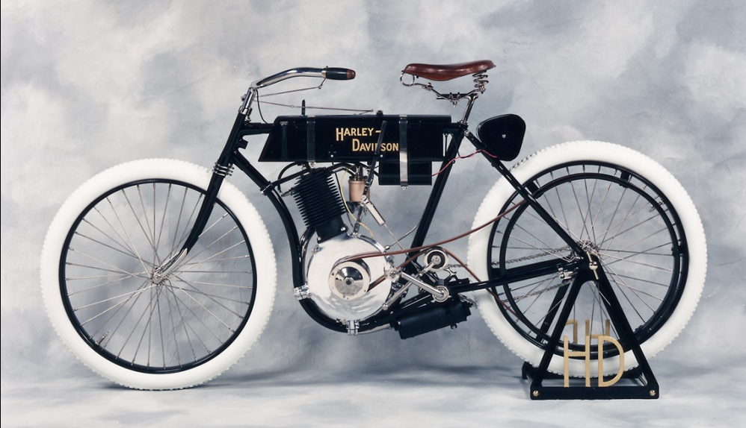
Notes:
At some point prior to 1903, William S. Harley and his next door neighbor and friend, Arthur Davidson had an idea to produce a motor-driven bicycle for their own personal use. They soon coerced Arthur’s brother Walter, who was a skilled mechanic, to help when he arrived back in Milwaukee for the wedding of their other brother William. Soon after, even William joined into the project lending his skills as an experienced toolmaker.
We produced and sold our first motorcycles in 1903, with total sales volume of three bikes. We have sold motorcycles internationally for 99 years – beginning with our first motorcycle exports to Japan in 1912. By 1920, we were the world’s largest motorcycle manufacturer. Today our motorcycles are sold in 77 countries worldwide.
6

Slide 7
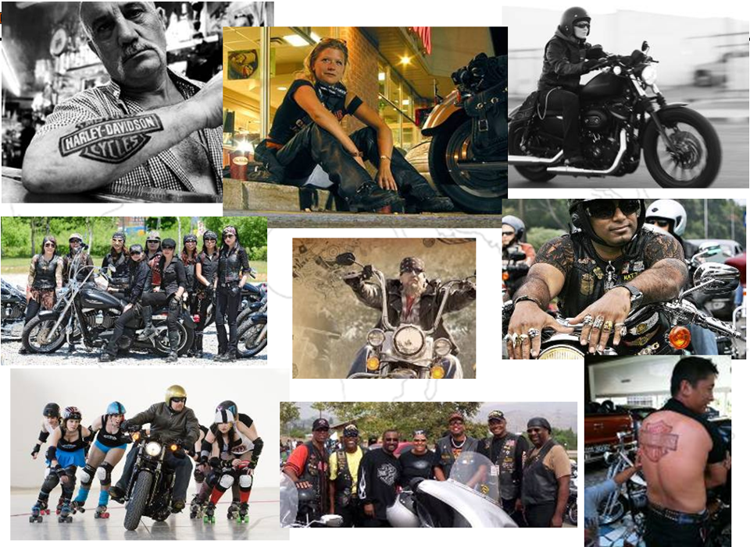
Source: 2006 ZMET Study of Harley-Davidson Motor Company
Notes:
!

Slide 8

Global: All Adults in various general populations
Harley-Davidson Global Brand Rankings
All Adults in General Populations
(H-D Ranking Relative to Other Brands in Each Market)
100
Germany
Niche or
Unrealized Potential
Czech Republic
USA
Leadership
Italy
Japan
UK
Mexico
Switzerland
Spain
France
Brazil
USA 2010
Canada 2010
UK 2008
Germany 2009
France 2009
Italy 2009
Spain 2009
Switzerland 2009
Czech Republic 2008
Japan 2010
Australia 2009
India 2009
China 2009
Brazil 2009
Mexico 2010
Canada
Energized Brand Strength
(Energized Differentiation / Relevance)
Ubiquitous
50
Australia
New or Unknown
Commodity or
Eroded
India
China
Unfocused
0
0
50
100
Brand Stature (Esteem / Knowledge)
Source: Global Consumer & Market Insights – Brand Asset Valuator Global Summary 2008 through 2010 – conducted December 2010
Notes:
As mentioned earlier, BAV is a global methodology and it provides H-D with a consistent lens of brand development understanding across the globe. In late 2010, a study was commissioned to understand H-D Brand Health in 13 international markets. This study has provided H-D with a never-before-seen consistent look at global brand health.
This chart represents the consumer reaction to the H-D Brand as measured in the respective general populations of each market (relative to all other brands in each market). As you can see, H-D is a Leadership Brand in the minds of the general population in most of its developed markets. Consumers in India & China are not yet familiar with H-D in a robust manner (which causes H-D to land in the “unknown” sector of the Powergrid). Interesting trends are occurring in both Australia and Canada which are reasons to dig further.

Slide 9
Global: All Adults in various general populations
Harley-Davidson Global Brand Rankings
All Adults in General Populations
(H-D Ranking Relative to Other Brands in Each Market)
100
Germany
Niche or
Unrealized Potential
Czech Republic
USA
Leadership
Italy
Japan
UK
Mexico
Switzerland
Spain
France
Brazil
USA 2010
Canada 2010
UK 2008
Germany 2009
France 2009
Italy 2009
Spain 2009
Switzerland 2009
Czech Republic 2008
Japan 2010
Australia 2009
India 2009
China 2009
Brazil 2009
Mexico 2010
Canada
Energized Brand Strength
(Energized Differentiation / Relevance)
Ubiquitous
50
Australia
New or Unknown
Commodity or
Eroded
India
China
Unfocused
0
0
50
100
Brand Stature (Esteem / Knowledge)
Source: Global Consumer & Market Insights – Brand Asset Valuator Global Summary 2008 through 2010 – conducted December 2010
Notes:
As mentioned earlier, BAV is a global methodology and it provides H-D with a consistent lens of brand development understanding across the globe. In late 2010, a study was commissioned to understand H-D Brand Health in 13 international markets. This study has provided H-D with a never-before-seen consistent look at global brand health.
This chart represents the consumer reaction to the H-D Brand as measured in the respective general populations of each market (relative to all other brands in each market). As you can see, H-D is a Leadership Brand in the minds of the general population in most of its developed markets. Consumers in India & China are not yet familiar with H-D in a robust manner (which causes H-D to land in the “unknown” sector of the Powergrid). Interesting trends are occurring in both Australia and Canada which are reasons to dig further.

Slide 10

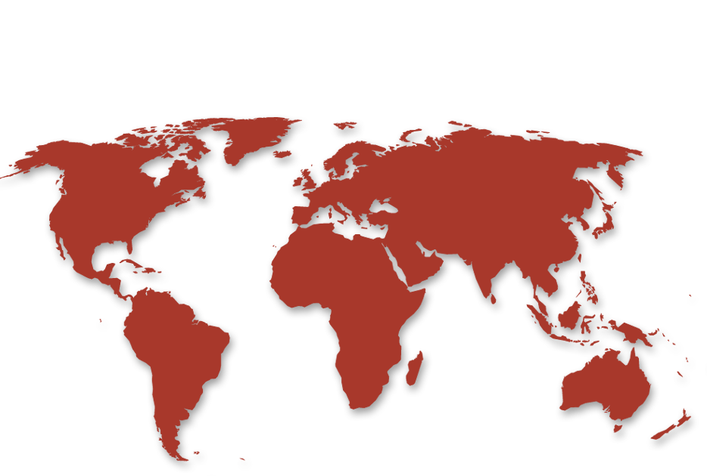
GEOGRAPHIC EXPANSION
Challenges in 2008-9:
Great Recession – 45% decline in US market
Milwaukee-centric organization
Investing in International Opportunities
Harley-Davidson brand
  central control vs. local interpretation
  new market entry
Notes:
10

Slide 11
Royal Enfield: Oldest Motorcycle Company

Slide 12
Growth Plans

Slide 13
North America Strategy
Take control of US and Canada markets
Establish US-based wholly-owned subsidiary company
  Sales, Marketing, Distribution, etc.
High impact Brand Awareness campaign
Develop geographic expansive, multi-layered Dealer network
Innovative approach – not traditional Powersports model
Grow Sales!

Slide 14
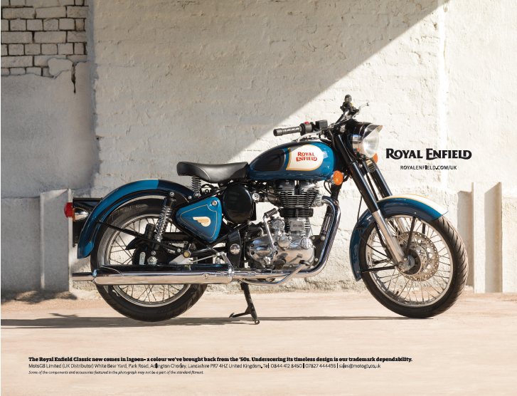
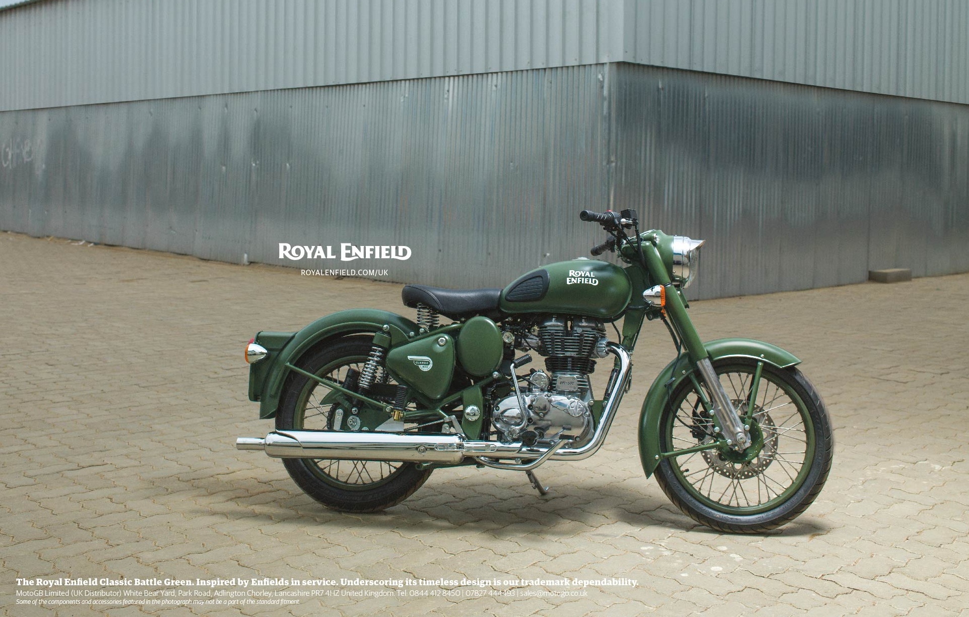
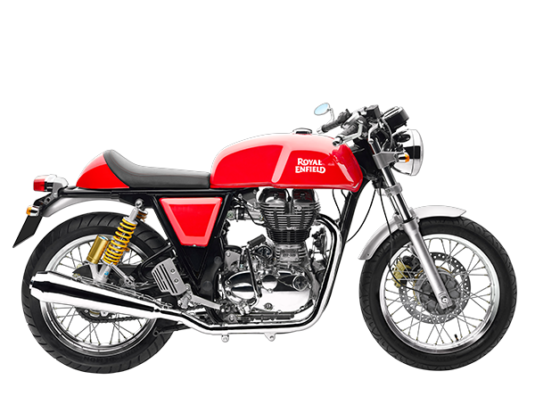
Motorcycles:

Slide 15
Similarities:
Rich histories
Iconic brands
Premium positioning
Modern Classic MC’s
Lifestyle brands

Slide 16
Differences:
Heavy-weight MC’s
75% domestic
$6 billion sales
$10,000 - $35,000
30+ models
Broad lifestyle offerings
Ave age = 45+
Middle-weight MC’s
98% domestic
$500 million sales
$5,000 - $6,000
5 models
Limited lifestyle offerings
Ave age = 28

Slide 17
Challenges:
Governments – trade and non-trade barriers
Company structure - culture and norms
Country Business Culture
Brand positioning
Motorcycle market

Slide 18

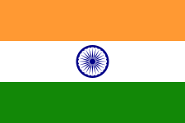
Governments:
No duties
No CKD required
Emissions requirements
High duties and taxes
CKD required
Sari guard required

Slide 19
Company:
India-centric
Small, fast growing
Minimal global experience
First outpost
Educate India office
Internationally-minded
Mature, established
Broad global experience
20 other Int’l offices
Learn from other Int’l offices

Slide 20
Country:
Roads - freeways
Speeds
Urban centers
Transparent business culture
Roads – crazy……
Riding conditions
Outside of cities
Sometimes confusing business culture

Slide 21
Motorcycle Market:
Under 500K/year
Recreation
Mature market
Dominated by heavyweights
Aging demographics
Over 12 million/year
Commuting
Growing market
Most < 150cc’s lightweights
Young demographics

Slide 22
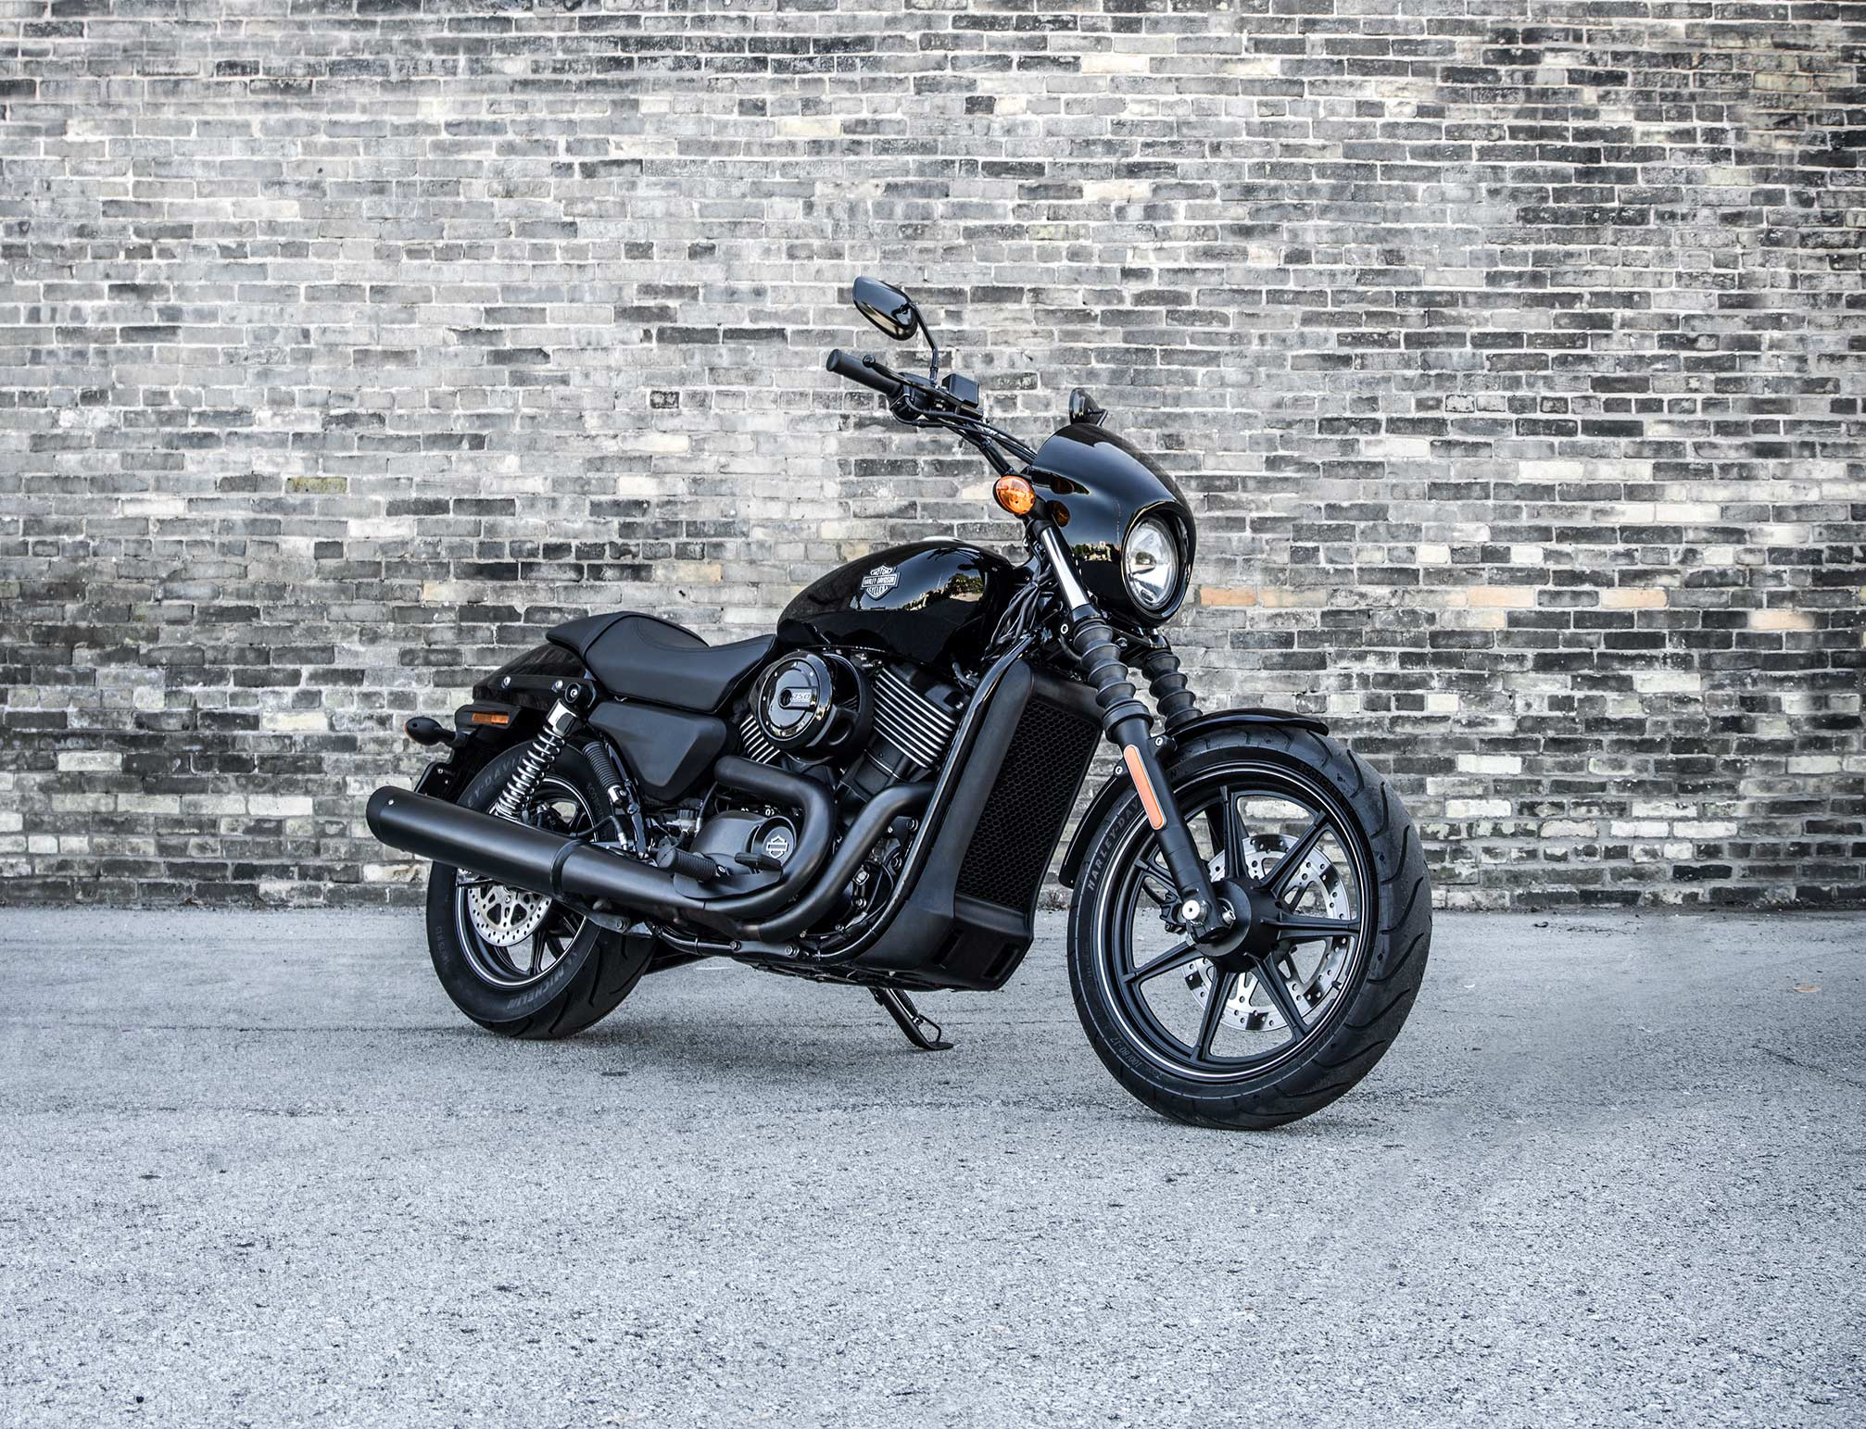
New Product:
Harley-Davidson Street

Slide 23
SUMMARY
Both great experiences
Both require learning …..
  About country, culture, norms, motorcycle market, etc.
Many dimensions to consider
Adapt, be open and flexible
Must develop unique, specific Strategy!
Enjoy your journey……..

Slide 24

Thank You

